Slide 1
Data Warehousing With IBM Cloud Db2 Warehouse
Team Members:
K.Mohamed shafiq
k.Lokesh
T.Kathiravan
P.Sachin prabhu
r.Surya prakash

Slide 2
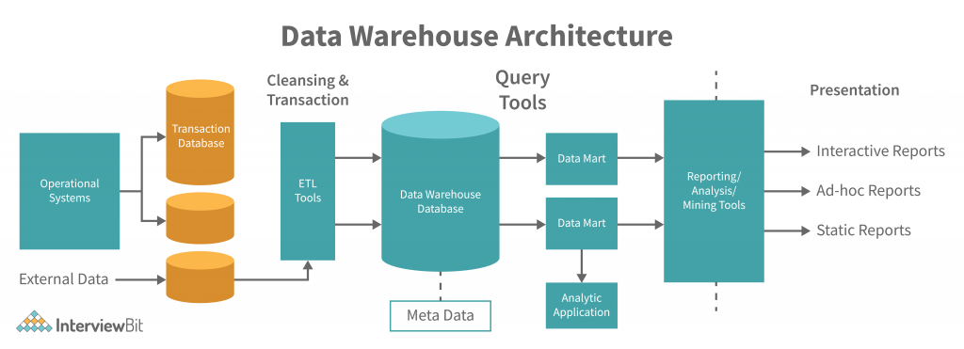
1. Data Warehouse Structure

Slide 3
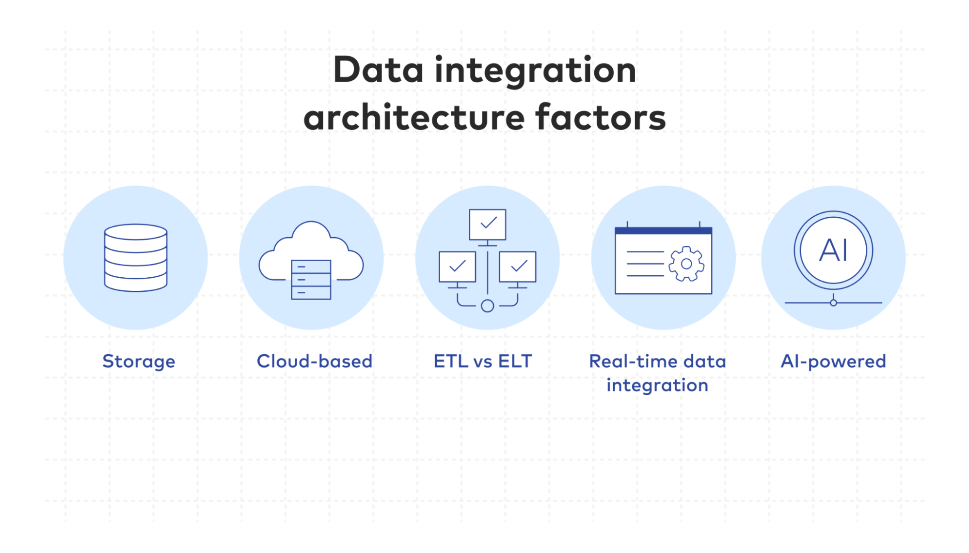
2. Data Integration

Slide 4
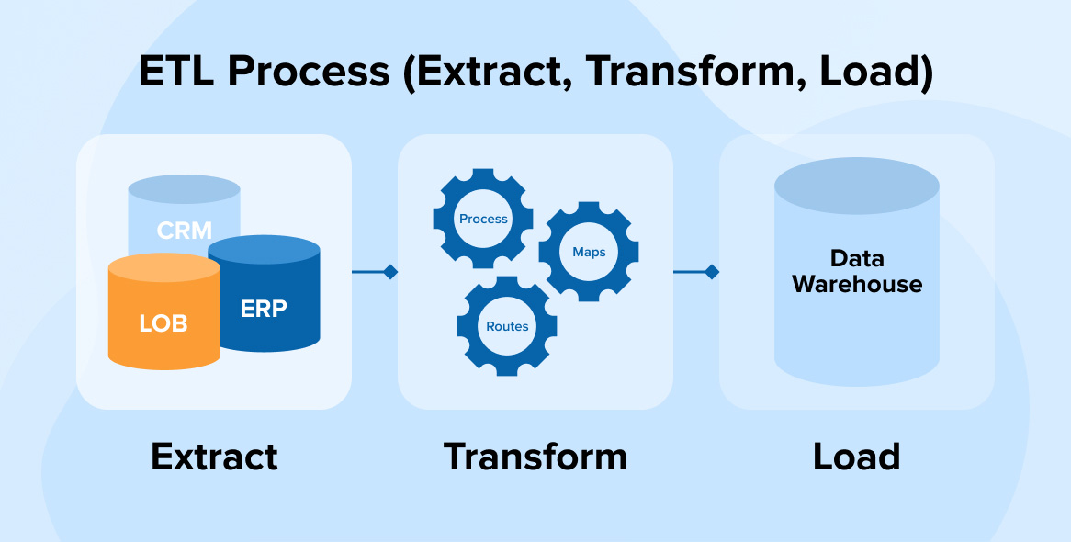
3. ETL Processes

Slide 5

4. Data Exploration

Slide 6
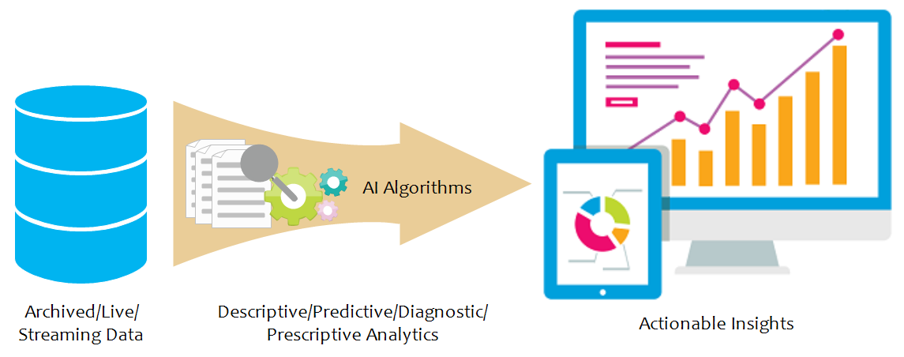
5. Actionable Insights

